Slide 1
NYC TAXI TRIP TIME PREDICTION
S.Bhargavi
221FA14004
BI - A
Submitted to: Abraham sir

Slide 2
INTRODUCTION
NYC Taxi Trip Time Prediction involves estimating the duration of taxi trips within New York City based on various factors like pickup/dropoff locations, time of day, traffic conditions, weather, and other relevant data. This is crucial for optimizing taxi services, improving route planning, and enhancing customer satisfaction.
Predicting trip times is typically done using machine learning models that analyze historical trip data. Commonly used techniques include linear regression, decision trees, random forests, and deep learning models, as well as real-time traffic information.
LINEAR REGRESSION
Linear regression is a statistical method used to model the relationship between a dependent variable (also known as the target or outcome) and one or more independent variables (also called features or predictors). The goal is to find the best-fit line that describes how the dependent variable changes as the independent variables change.

Slide 3
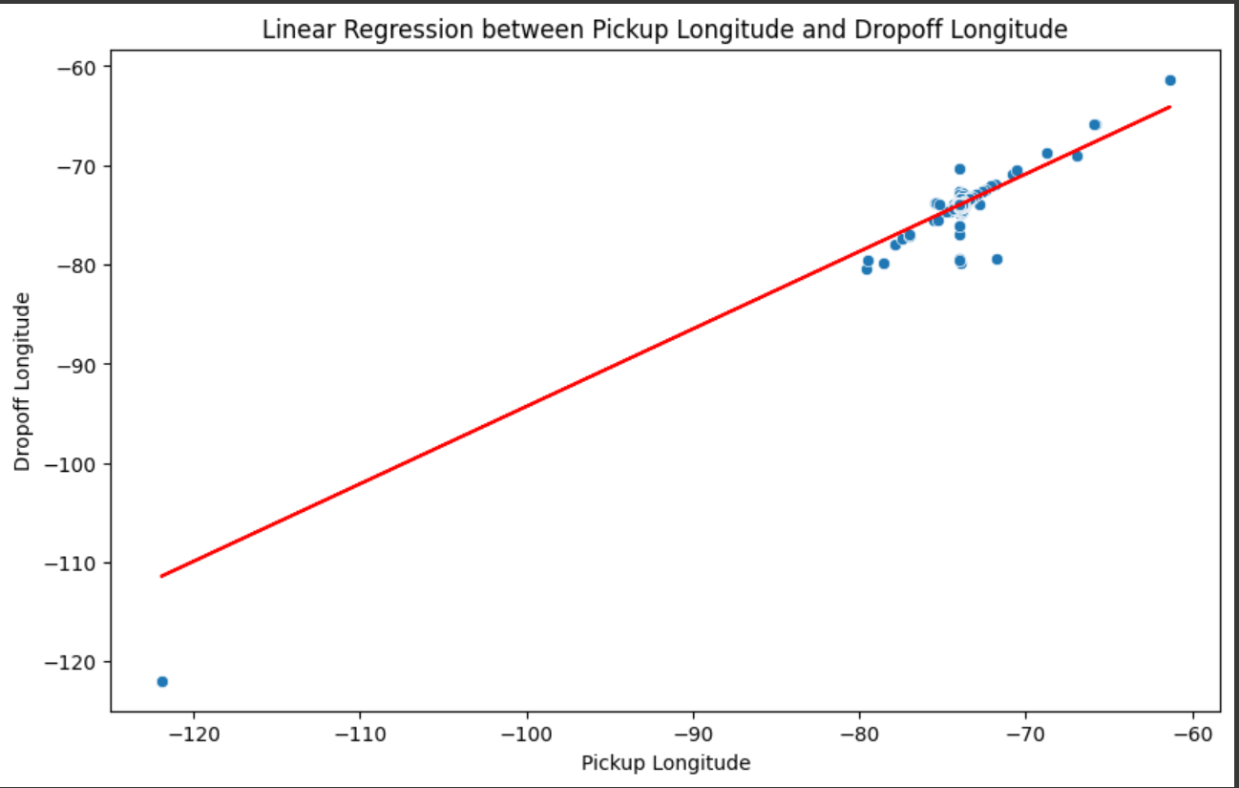
Python using google collab
The graph shown represents a linear regression analysis between the
Pickup Longitude (X-axis) and Dropoff Longitude (Y-axis)
Data Points: The blue dots represent individual taxi trips, with each dot indicating a pair of pickup and dropoff longitudes
Regression Line: The red line represents the fitted linear regression model, showing the best-fit relationship between the two variables.

Slide 4
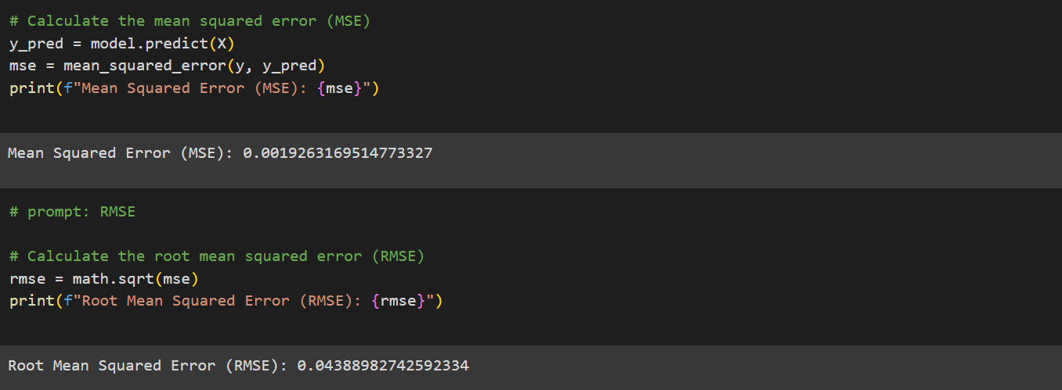
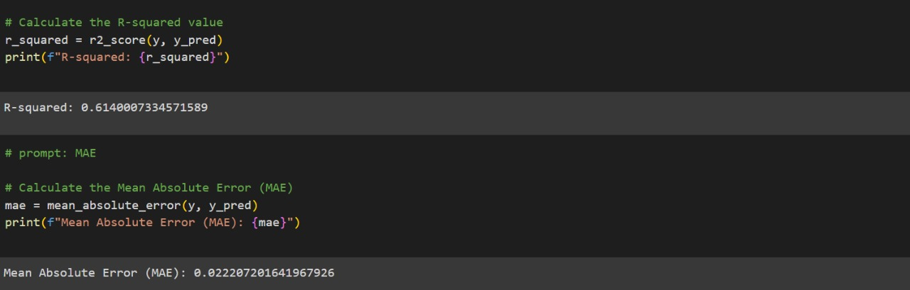

Slide 5
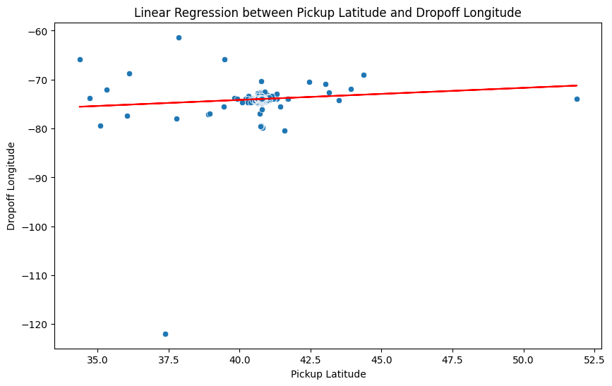
Python using google collab
The graph depicts a linear regression analysis between
Pickup latitude(X-axis) and
Dropoff longitude (Y-axis)
Data Points: he blue dots represent individual data points, each corresponding to a specific pickup and dropoff location.
Regression Line (Red Line): he red line is the regression line, which represents the best-fit linear relationship between the two variables.
The slope of the regression line indicates the relationship between pickup latitude and dropoff longitude.

Slide 6
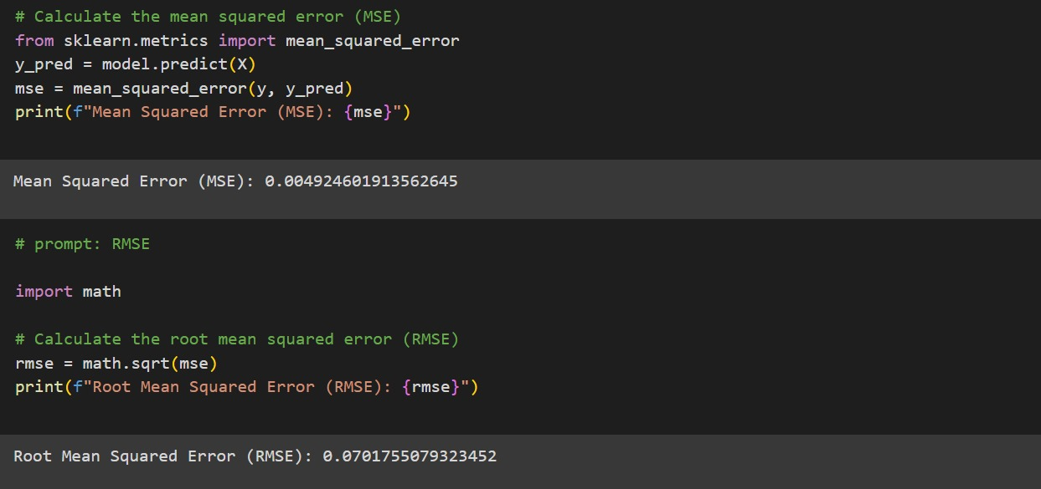
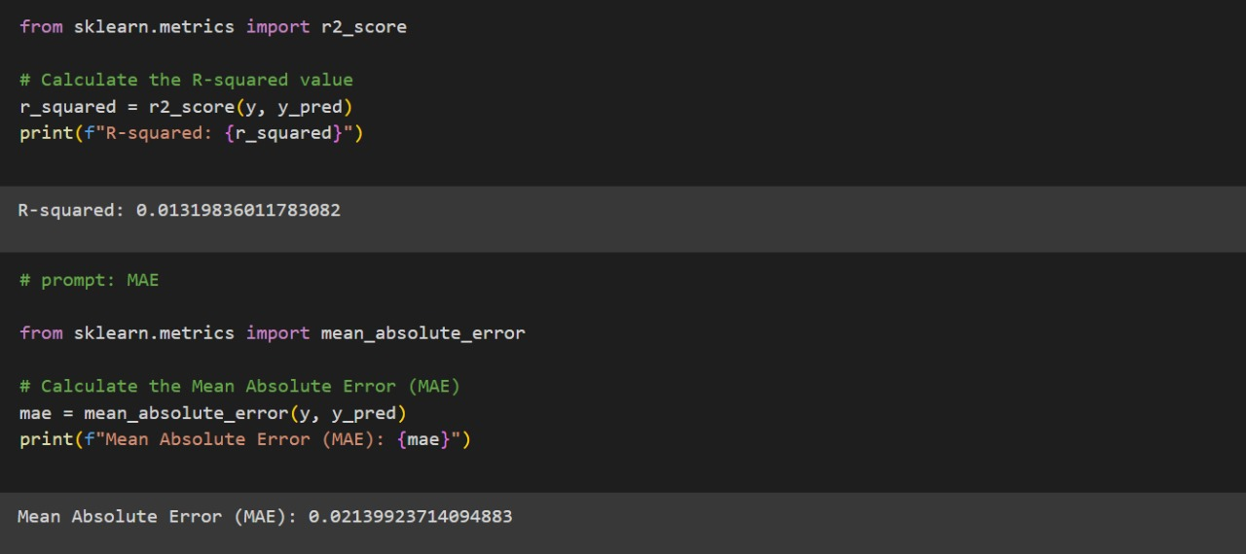

Slide 7
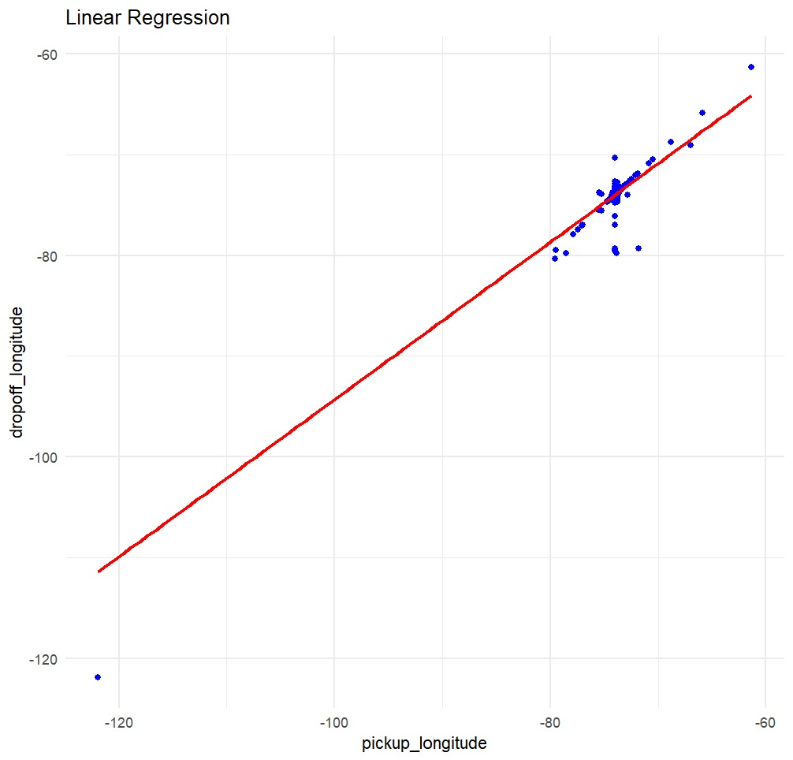
R using rstudio
The graph shows a linear regression analysis between pickup_longitude (X-axis) and
dropoff_longitude (Y-axis)
Data Points: Each blue point represents an observation, plotting the relationship between pickup and dropoff longitudes for a taxi trip.
Regression Line (Red Line): The red line is the best-fit linear regression line, showing the general trend between pickup and dropoff longitudes.

Slide 8
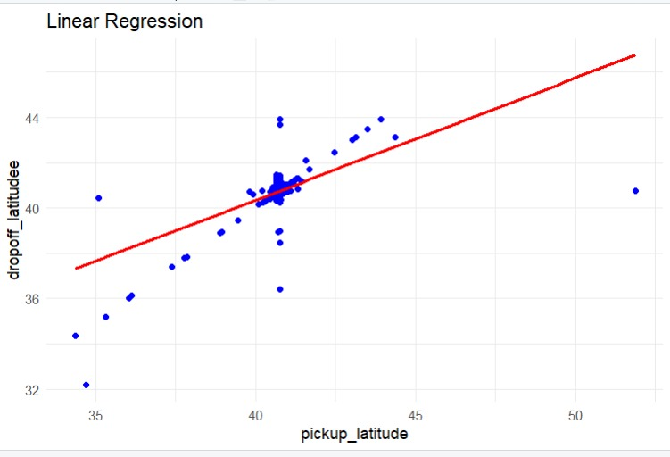
R using rstudio
The graph illustrates a linear regression analysis between pickup_latitude (X-axis) and dropoff_latitude (Y-axis)
Data Points: The blue points represent individual taxi trips, showing the relationship between the latitude at which the trip started (pickup_latitude) and where it ended (dropoff_latitude).
Regression Line (Red Line): The red line represents the linear regression model, showing the predicted relationship between the two variables. It indicates that as the pickup_latitude increases, the dropoff_latitude also tends to increase.

Slide 9
THANK YOU

